Slide 1

Lesson 6 CN4003: Images and Graphics in Web Design
Dr Fadi Safieddine
1
Dr. Fadi Safieddine copyright 2021

Slide 2
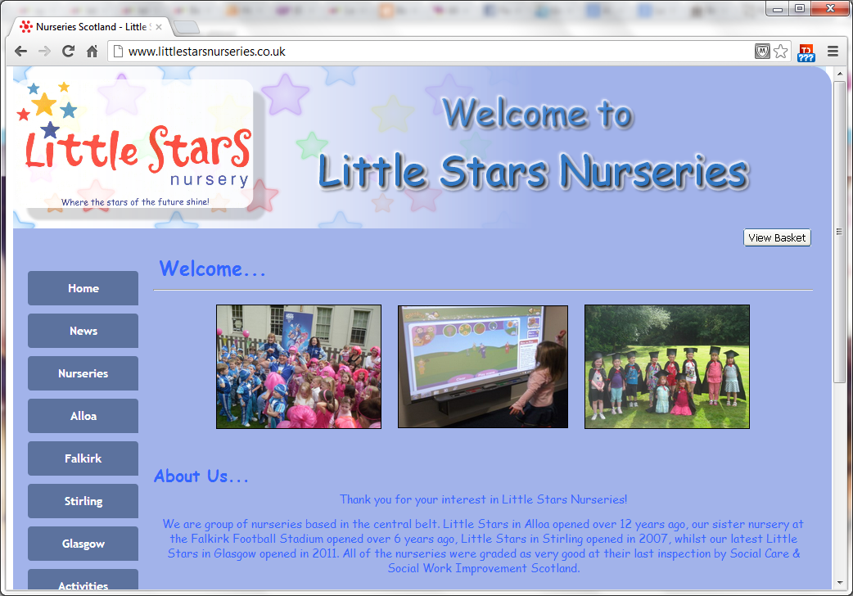
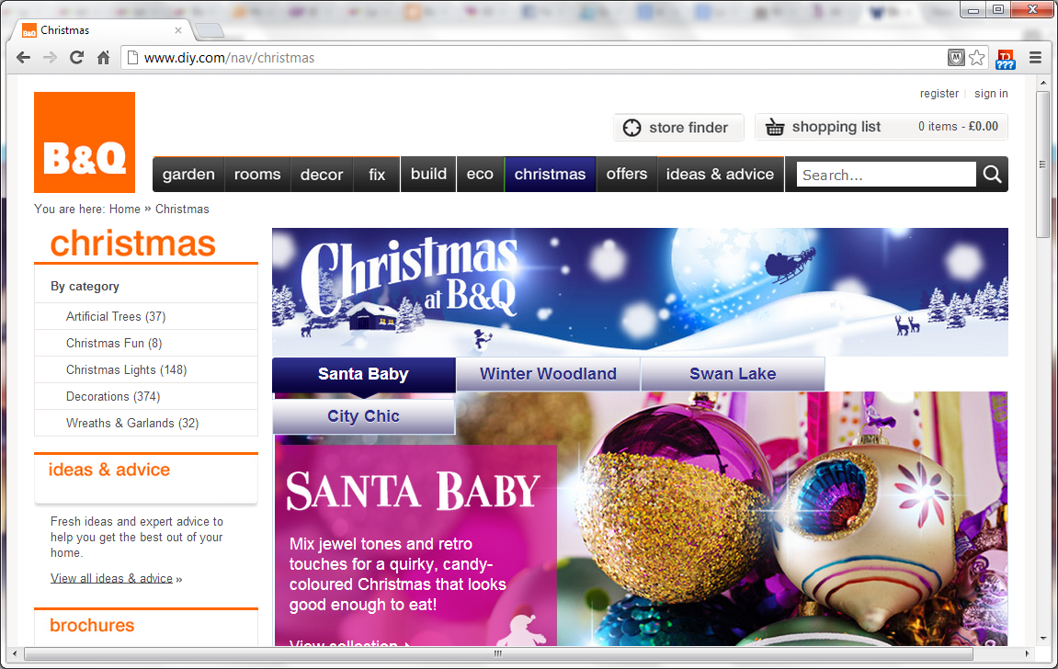
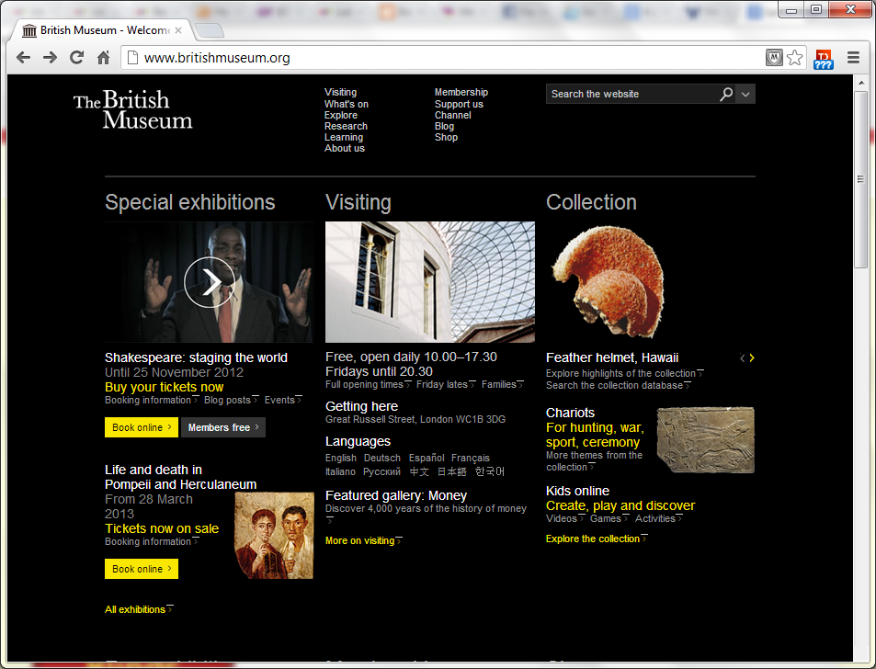
Lecture content
Why images are important?
Types of images.
What are bitmap images:
Resizing images
Different formats
Look at the tools
Why you need these skills beyond this module.
UEL Photoshop
Editing tools
Resizing images
Different formats
Free web-based tools.
2

Slide 3
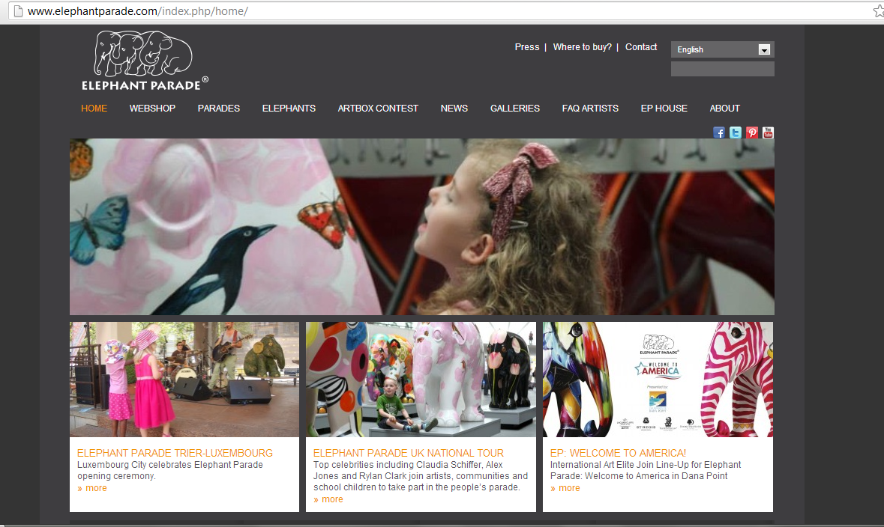
Importance of images
An image is worth a 1000 words
Graphics make a website!

Slide 4
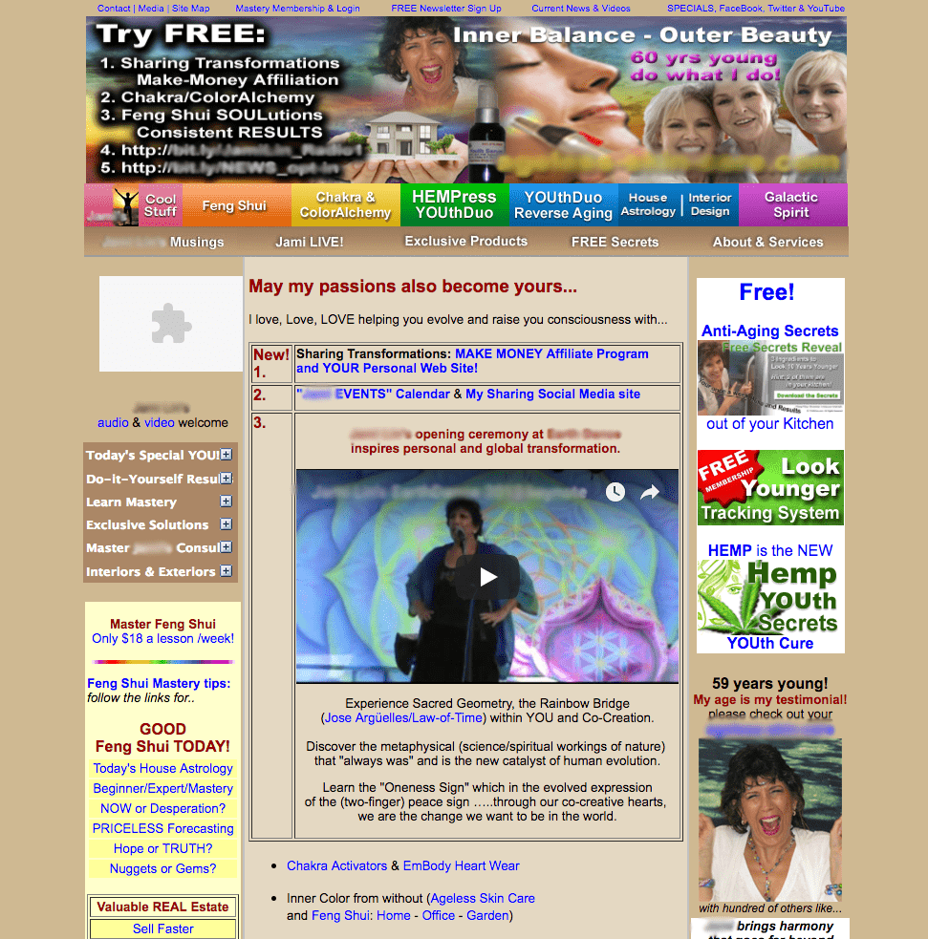
Importance of images
An image is worth a 1000 words
Graphics make a website!

Slide 5
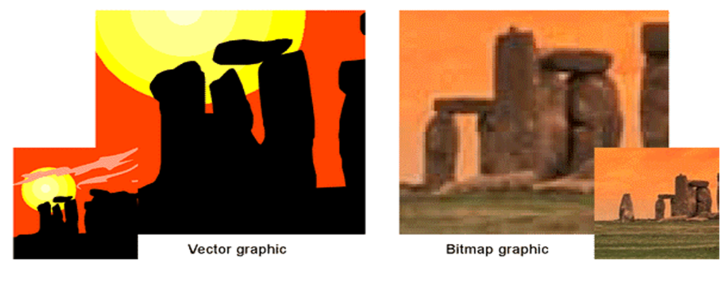
Types of images:
Bitmapped Images: are stored as a collection of dots (pixels), with location and colour of each pixel.
Vector Graphics: are stored as a collection of formulas: data and parameters that defines the shapes and where are located.

Slide 6
Types of images:

Slide 7

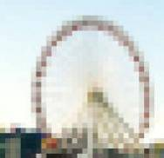
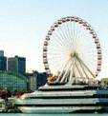
Resolution: Pixels
What About Resolution?
one
pixel
“Resolution” = number of pixels per inch in a bitmap image
The more dots per inch (dpi), the higher the resolution
Higher resolution means a better quality image
Notes:
“Resolution” refers to the number of pixels, or dots, per inch in a bitmap image. An image with 1 bit of color information per pixel. (all photos or scans are bitmap images)
PowerPoint only displays at 72 dpi onscreen, so a 300 dpi image will look exactly the same as a 72 dpi image while taking up a lot more memory

Slide 8
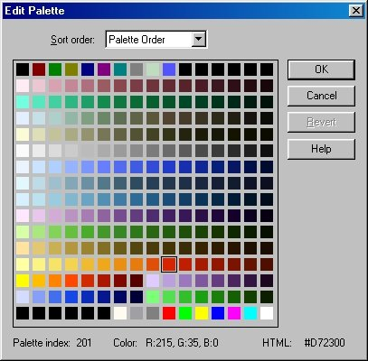
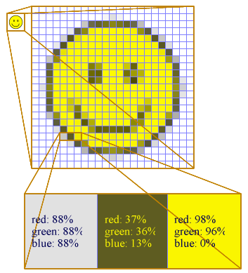
Bitmap Color
Each pixel has color and a color depth. We can define that by ‘Bits’ e.g., held as an RGB value.
For 256 colors a palette can be used as an index describing which actual colors to use in an image.
#FFFF00
#255,255,0
#11111111,11111111 00000000

Slide 9
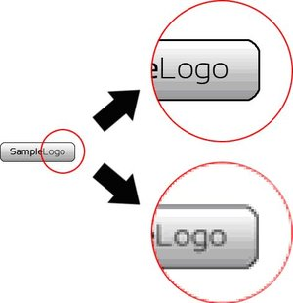
Bitmap: Resizing and Clipping
Resizing: scaling up or down
Original coordinates – used to define model layout
New coordinates – correspond to display location
Involves repixelling around the original design
Clipping: Clips to the visible area of the window (Crop)

Slide 10
Resizing a bitmap image
Actual pixels
Scale = 1
Scale = 2
The process to map one logical pixel to more than one actual (physical) pixel will require a decision about where to assign on the physical pixels
Many times duplication of these values leads to ‘jagged edges’ – which leads to a pixelated image.
This is visible on screen and printouts.

Slide 11
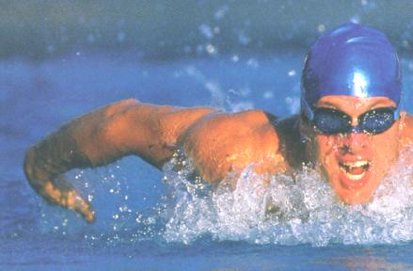
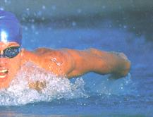
What Resolution Should I Use?
Can you tell the difference on screen? How about if you print it?
300 dpi
72 dpi
DPI stands for: Dots Per Inch

Slide 12
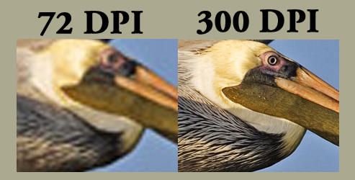
What Resolution Should I Use?
Can you tell the difference on screen? How about if you print it?

Slide 13
What Resolution Should I Use?
So, what’s the difference?
300 dpi
72 dpi
This image is 1.4 MB
This image is 240 KB
Notes:
NOTE: Since PowerPoint embeds images into the file, using smaller images will help prevent the PowerPoint file from getting too big and possibly crashing.

Slide 14
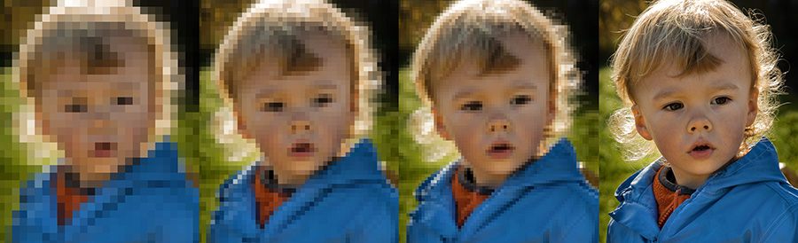
End of Part 1
Activity 6.1. Looking at the three images printed below and the three different possible DPI settings, can you guess which one is which?
30DPI, 120DPI, 300DPI
Image A Image B Image C

Slide 15
What Resolution Should I Use?

Slide 16
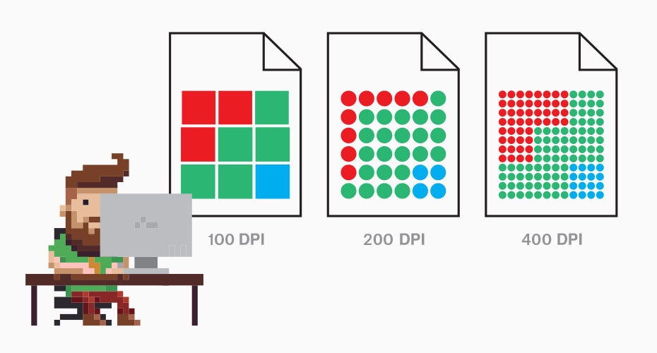
What Resolution Should I Use?
Higher Pixels when taking pictures
Higher DPI when displaying them
Compression is everything!

Slide 17

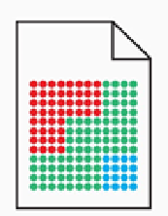
Saving Bitmap images: Formats
Can be saved to up to 50 different formats:
Include: JPEG, TIFF, BMP, GIF, PNG …….
Main differences is in the compression technique to store the number of bits, pixel values, and the colour depth.
We have two types:
Lossless compression: Image compression that can be decompressed to its original or very near (e.g PNG – and it is reason why they tend to be large files.)
Lossy compression: some information is lost during the decompression. May result in poor quality although some formats are renounced for good quality and great compression rate, such as JPEG (JPG).

Slide 18
Lossless verses Lossy

Slide 19

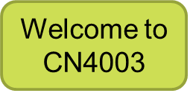
Compression - PNG / JPG
Dimensions: 1249 x 708 pixels.
PNG compressed = 1.1MB
JPG compressed = 0.1MB
Dimensions: 200 x 157 pixels.
PNG compressed = 37k
JPG compressed = 3.4k

Slide 20
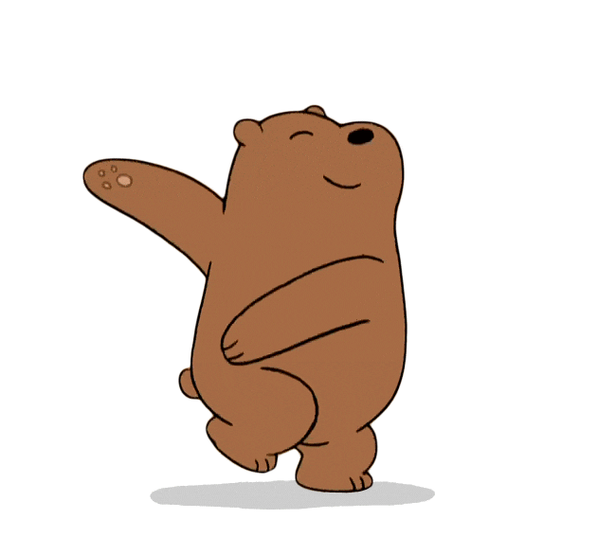
Different formats:
GIF
Allows exchange of images across different platforms
Limited to 256 colours per one byte.
Lossless compression
Allows transparency
Suitable for images with limited colour range, not recommended for photographic images
Used mostly for GIF animations
PNG
Stores objects and layers for better editing
Lossless compression but uses different compression technique.
Transparency retained, in more sophisticated form
Has more than 256 colours.
Tends to have larger files than GIF

Slide 21
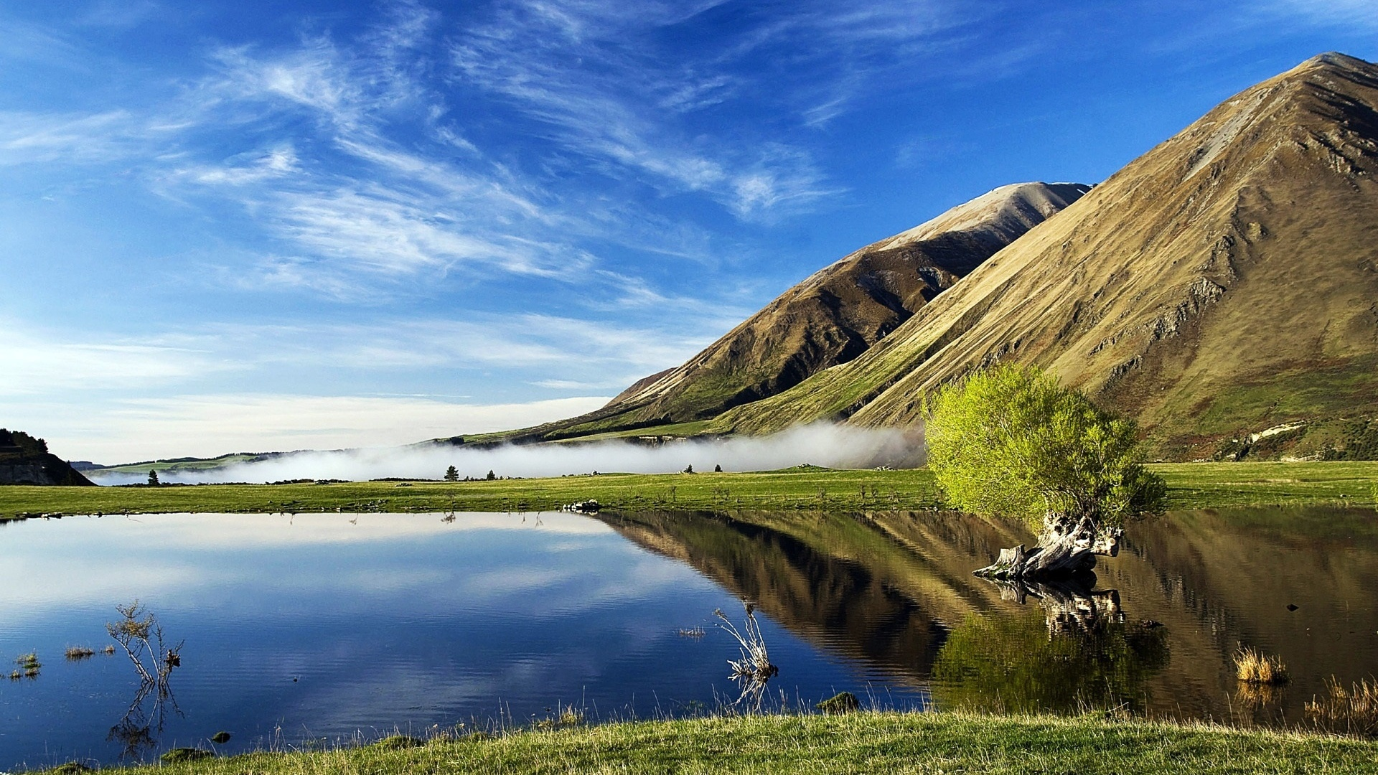
Different formats
PNG

Slide 22
Different formats:
JPG
Best example of Lossy compression.
JPG image use JPEG compression techniques.
Compression factor can be controlled with higher compression = more loss + lower quality = Smaller file and vice versa.
Suitable for images with large ranges of colours such as photographs
Not suitable for editing and re-editing.
Ideal for use on the Web.

Slide 23
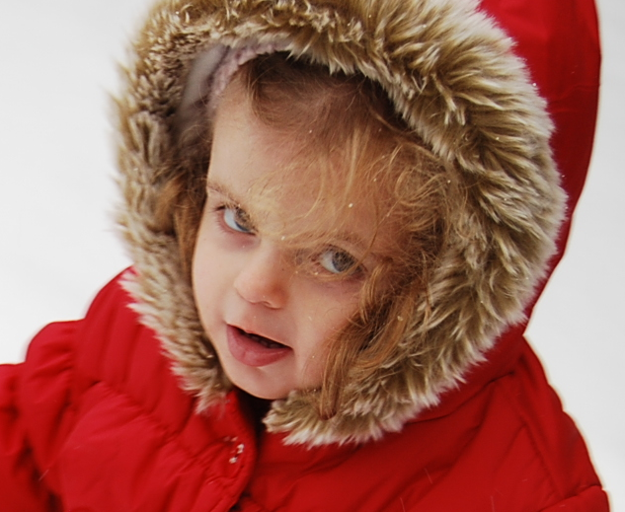
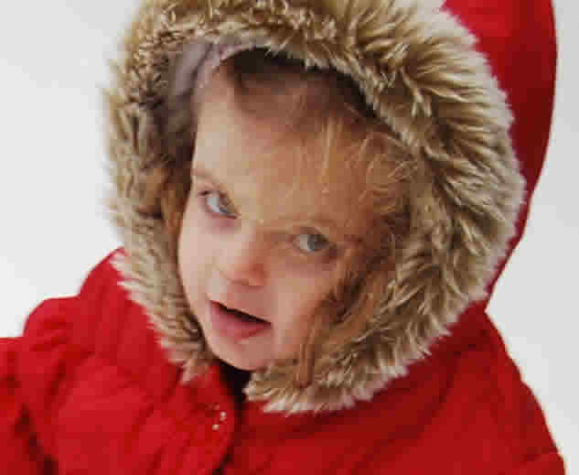
JPEG and Compression

Slide 24
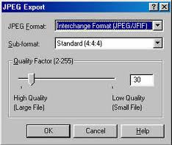
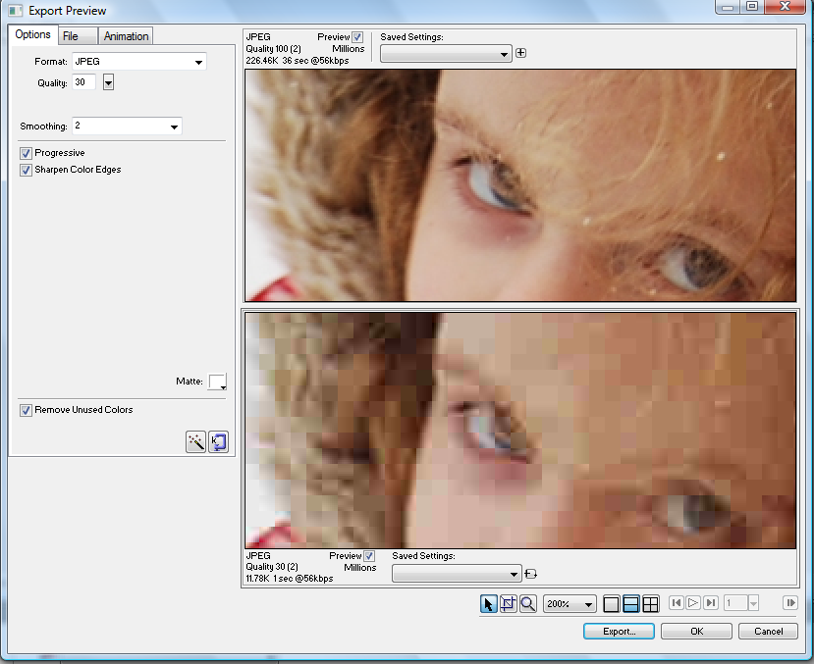
JPEG and Compression

Slide 26
Comparison
Image size 630 * 520 pixels
Picture.PNG 861KB
Picture.jpg (15%) 31KB
Picture.jpg (50%) 16KB
Picture.jpg (70%) 11.2KB
Picture.gif (256 colors) 106KB
Picture.gif (128 colors) 86KB

Slide 27
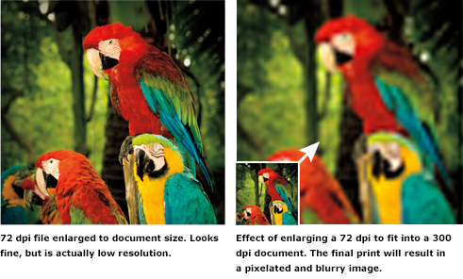
Resizing creates pixilation problems.

Slide 28
End of part 2
Activity 6.2. Assign best practice associated with each image format as discussed in the lesson:
Which one is best for low storage while maintaining good quality as Web images.
Which one is best for low quality animation.
Which one is best for high quality printing.

Slide 29
What difference graphics can do?

Slide 30
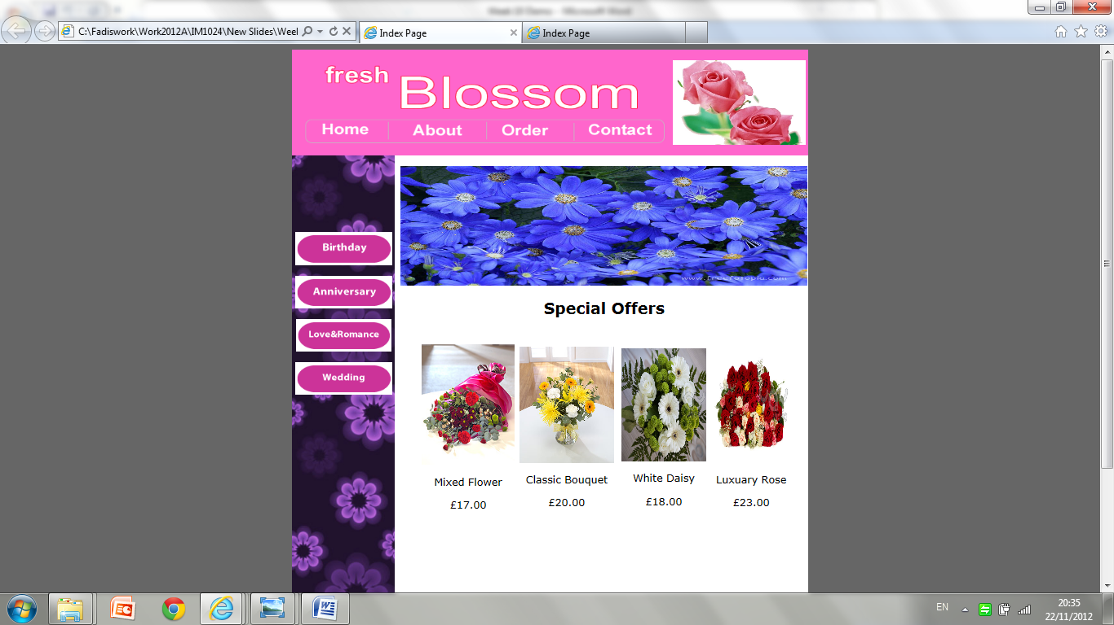
What difference graphics can do?

Slide 31
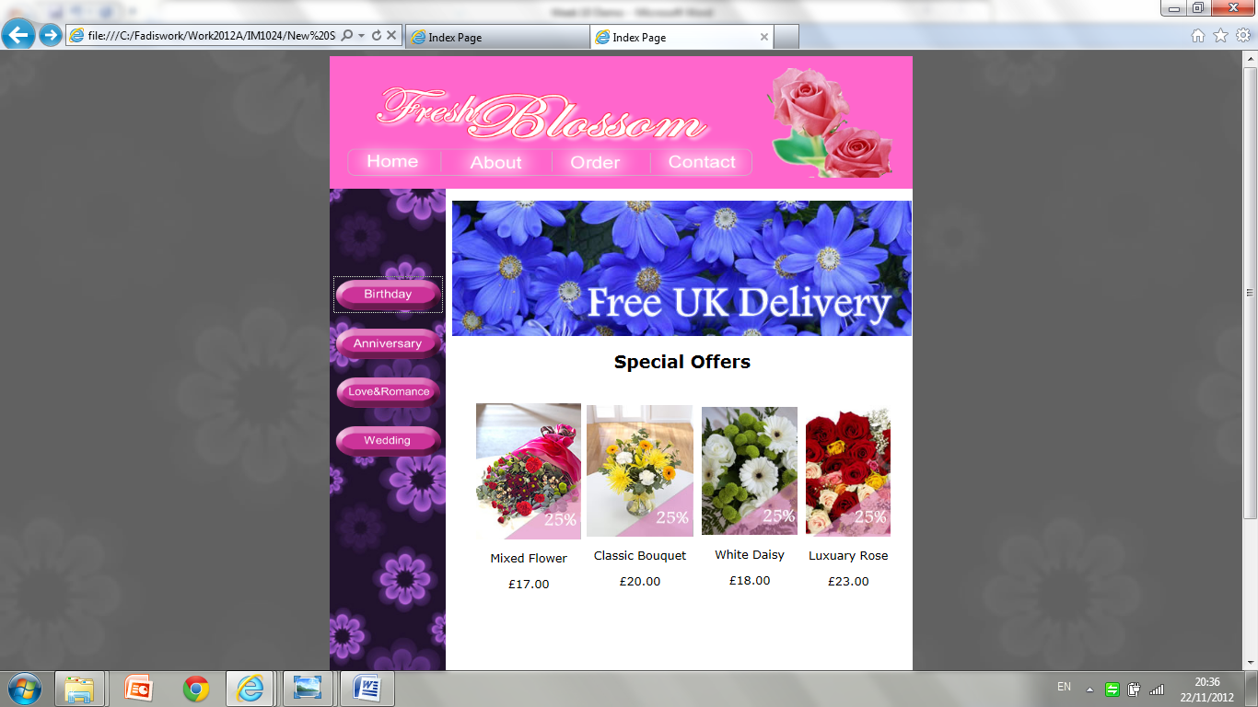
What difference graphics can do?

Slide 33
Using Graphic Design tools
In almost every programming and application development context, it is judged by its presentation.
Menus
Manuals
Games

Slide 34
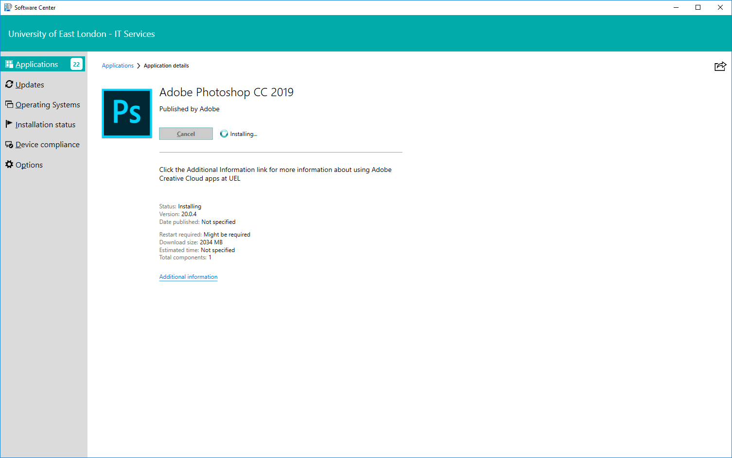
Using Photoshop at UEL
Download Photoshop from Software Centre at UEL computers.
Note: Software takes long time to install.

Slide 35
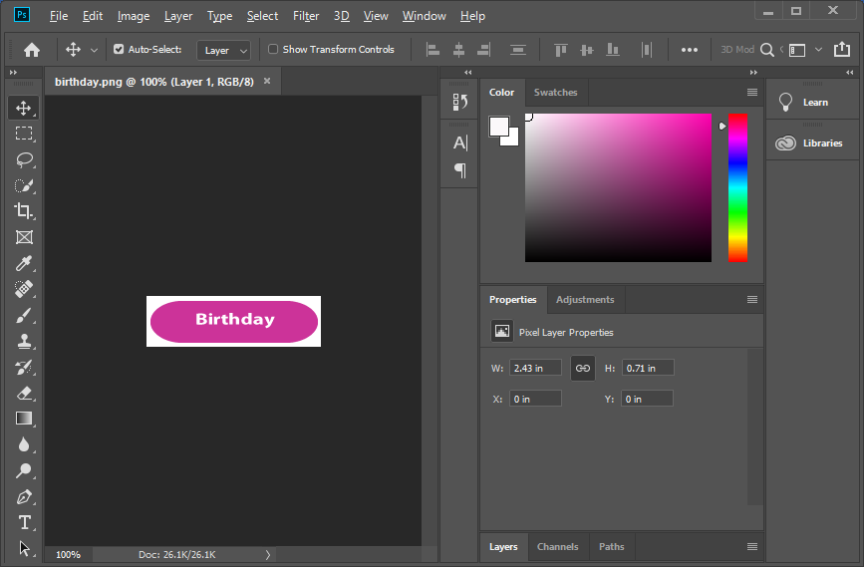
Lecture Demo of Photoshop
Refer to the handout practice found in week 7 on Moodle.

Slide 36
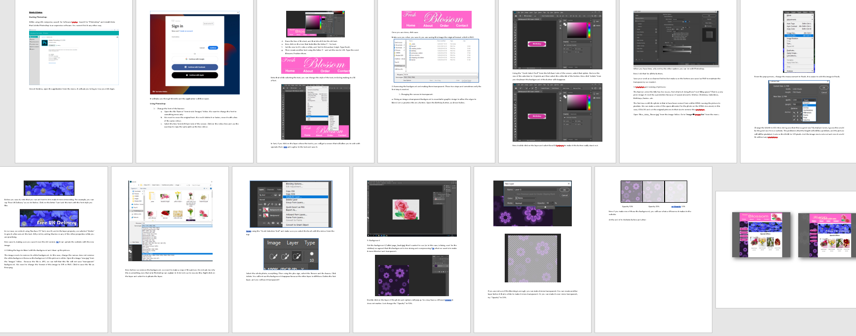
Lecture Demo of Photoshop
Refer to the handout practice found in week 6 on Moodle.

Slide 37
Recorded Demo of Photoshop

Slide 38
Recorded Demo of Photoshop

Slide 39
End of part 3
Activity 6.3. Download Adobe Photoshop demo version.
Practice some of the activities to be submitted part of Lab Practice 6.1.

Slide 40
Using online tools:

Slide 41
Using online tools:
Many free online tools.
All have very similar features.
Much cheaper and more accessible than Photoshop:
https://pixlr.com/
https://www.befunky.com/features/photo-editor/
https://ipiccy.com/
https://www5.lunapic.com/editor/
https://www.online-image-editor.com/

Slide 42
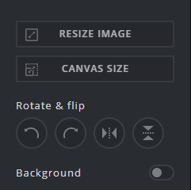
Features:
Image resize verses canvas resize
Rotate & flip images

Slide 43
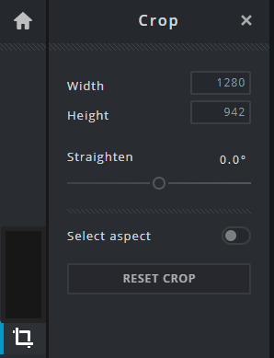
Features:
Cropping: to cut the image down.
Manual
By numbers.

Slide 44
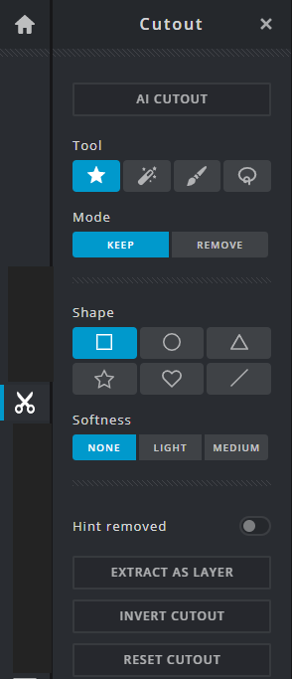
Features:
Cutout:
Could be shape
Freestyle
And other options

Slide 45
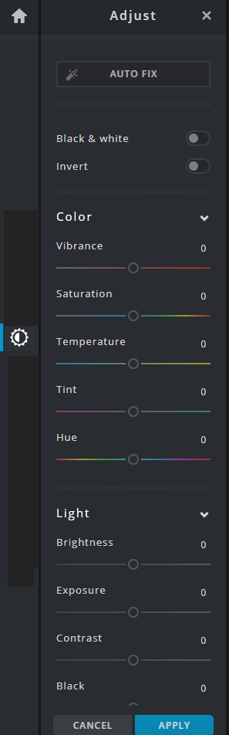
Features:
Filters and shades:
Black & White
Invert
Colours
Lights

Slide 46
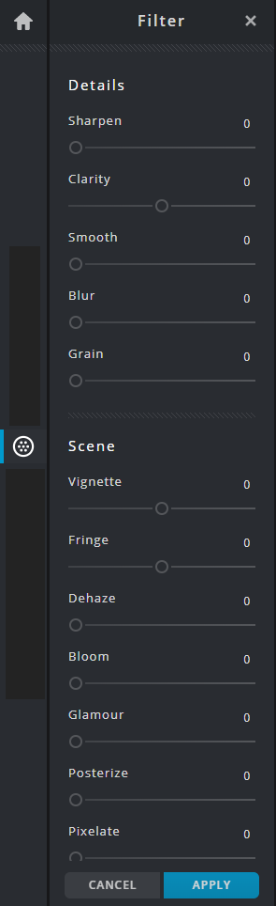
Features:
Filters and shades:
Sharpen
Blur
Grain
And variety of tools.

Slide 47
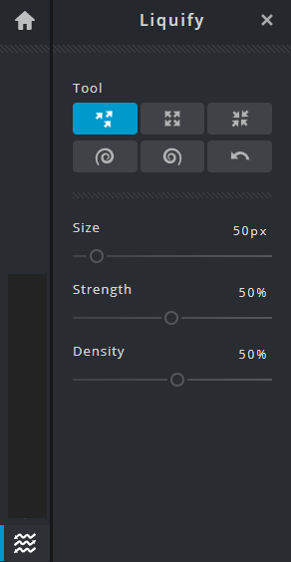
Features:
Play with the tools that allow image editing

Slide 48
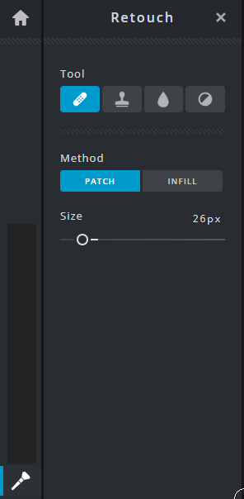
Features:
Play with the tools that allow image editing

Slide 49
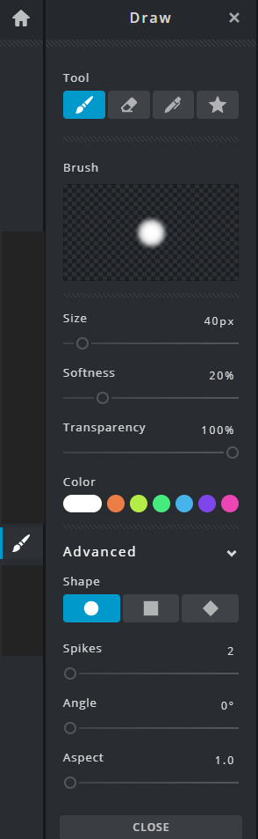
Features:
Drawing:
Selecting tool,
Features,
Colours,
And shapes

Slide 50
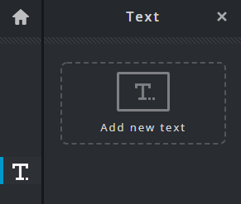
Features:
Writing Text:

Slide 51
Recorded Demo of online tool:

Slide 52
Talk about the Assignment:
How are you progressing with the assignment?
You should complete the work up to task 2 (minimum).
Finish Task 3 by next week.

Slide 53
End of part 4
Activity 6.4. Use the web based website demonstrated in the lesson.
Practice some of the activities to be submitted part of Lab Practice 6.2.

